Slide 1
Trigger- effect/identities
Pal Tamas

Slide 2
Some Data
Data from the EU's statistical office shows that between 1975 and 1995 the EU population grew by just over 6%. From 1995 to 2025 however, this growth is expected to almost half to roughly 3.7%.
Another reason is that the population's average age is increasing. The working-age population was 225 million in 1995, and is expected to remain fairly constant at around 223 million in 2025. The striking point, though, is that the over-65 population is anticipated to rise from 15.4% of the EU population in 1995 to 22.4% by 2025.
These population trends are not evenly spread. Population growth has hit record lows in southern European countries.

Slide 3


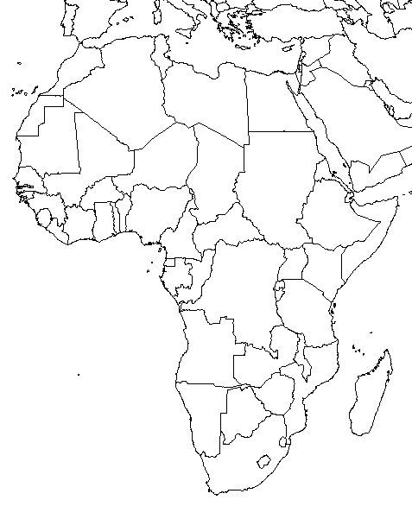
Main challenges ahead: treating Africa as one
Euro-Mediterranean Partnership with North Africa
+
Neighbourhood Policy
Cotonou Agreement with sub-Saharan Africa
Agreement on Trade, Development and Cooperation with South Africa

Slide 4
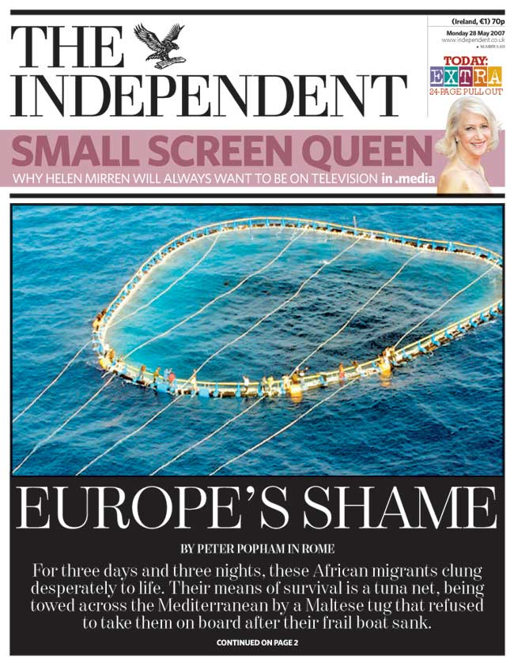
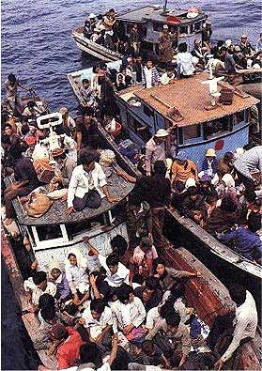
Crossing the Mediterranean

Slide 5
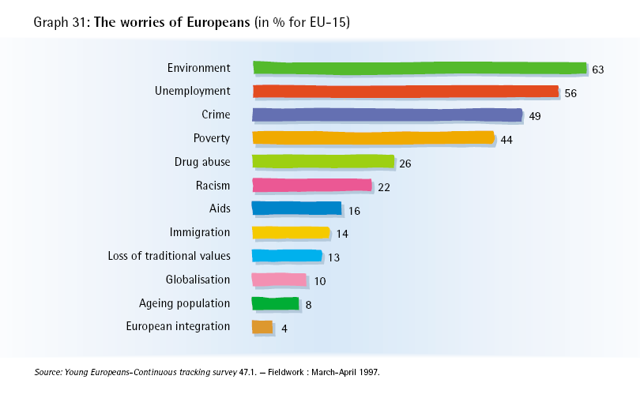
Shared fears? 1997

Slide 6
Shared fears 2015 September
Eurobarometer last wave [2015 september]
Most important –migration, energy

Slide 7
Feeling European
Barometer 1999
  Feeling ‘European’ in Luxemburg, Italy, Spain, France, Belgium, the Netherlands, Austria and Germany
  Feeling ‘national’ in UK, Sweden, Funland, Greece and Denmark
Barometer 2004
  86 % is proud of their country, 68 % is proud of Europe
  But, 49 % feels there is no shared cultural identity

Slide 8
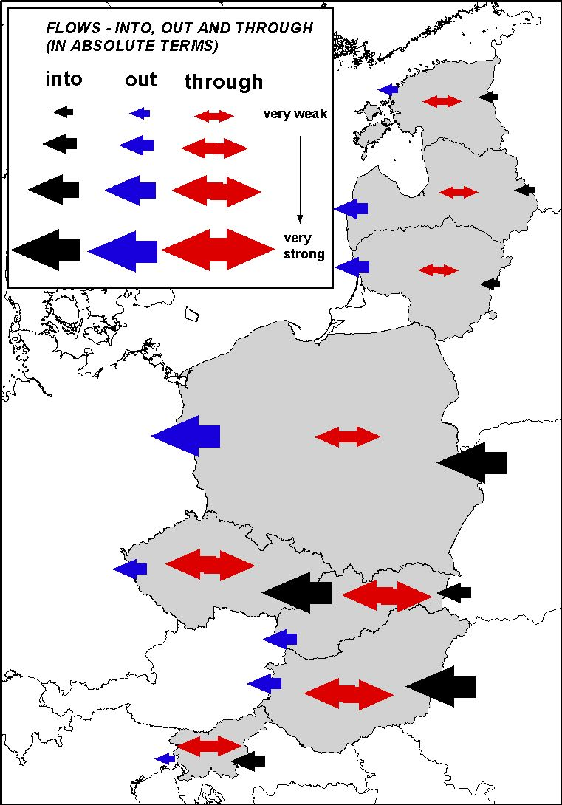
CURRENT MIGRATION PATTERNS – ESTIMATES: FLOWS INTO, OUT, THROUGH (in absolute terms)

Slide 9
Citizenship and the nation state
We need to distinguish a strong and a weaker sense of citizenship
  Bare citizenship (under Geneva convention)
    passports, right to work, duty to pay tax
  Cultural citizenship as ‘Identity generating and community building’
  (Weiner, 1998)

Slide 10
Bare Citizenship
Citizenship rich
  Legal situation has made two or more passports possible in the US and Australia
  In the EU, all citizens have transnational citizenship rights
Citizenship poor
  Refugees
  Expatriate citizens of poorer countries who offer little consular protection

Slide 11
Assimilation under pressure
EU context of transnational citizenship puts pressure on the French model
the multicultural self-understanding of the nations of citizens formed in classical countries of immigration.. is more instructive..than that derived from the culturally assimilationist French model (Habermas 2001:159-160).

Slide 12
Reislamisation in Paris
Olivier Roy: Reislamisation is new form of individualised Islam, suited to disenfranchised youth.
Unemployment 20-40% in suburbs such as Clichy-sous-Bois.
Riots fuelled by French traditions of liberté, egalité, fraternité

Slide 13
Lakemba and the west
Sydney’s western suburbs have been home to the post civil war group of Lebanese migrants, a group sharply distinguished from Maronites who came earlier
High unemployment and radical Islamic clerics flourish in western suburbs

Slide 14
Identity generating
Young rioters are French
the rioters were unmistakably French, and not only because almost all were citizens. They have internalized French political values so well that they want France to live up to its promise of liberty, equality and fraternity. Their dream was not to overthrow the system, but to make it work so they could get ahead too. Political violence is as French as baguettes and berets. (Heneghon 2006)

Slide 15
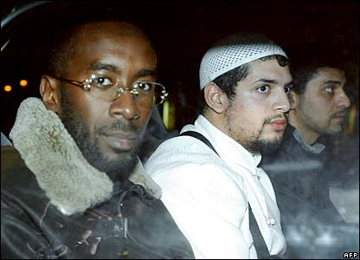
Berets and baguettes?

Slide 16
Hybrid citizenships
‘The coexistence of rival ways of life in individual experience’ Beck
transnational and national media worlds
world view/mediascape which includes but is not limited by the nation state
The myth: a culturally homogeneous nation state

Slide 17
Citizenship debate in sociology
TH Marshall (1950): civil, political, social citizenship (citizenship as rights). Inequalities: implicit economic model
Turner/Lister and debate of 1980s/Wallace and Jones life cycle citizenship: about universalism and in/exclusion
Rights and mobilisation of rights (Barbalet) Role of civil society (Keane)
Move towards citizenship as participation in 1990s (social capital, social inclusion)
Citizenship debate mainly at a national level
Different models of citizenship in Europe and different meanings of citizenship (Brubaker) but we are using that of the Crick Report.
European citizenship: not much discussed.

Slide 18
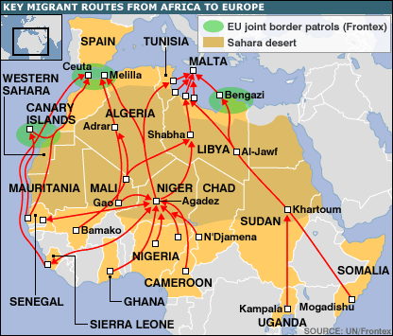
Part II: Migration
In 1620, one of 10 people in the Netherlands was foreign born. In a town as Amsterdam, this could be as much as one in four!

Slide 19
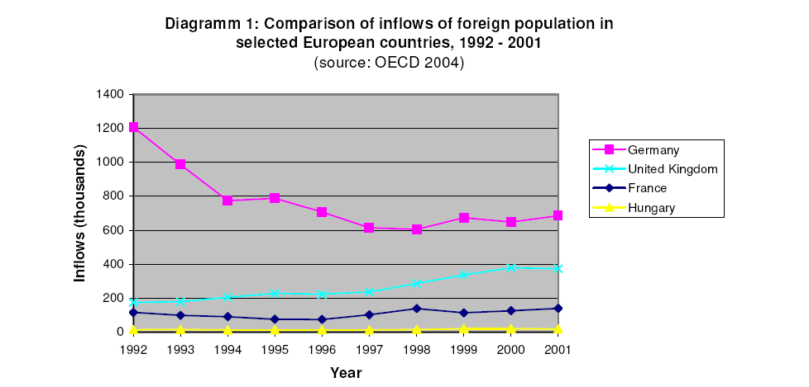
. There are probably between 2 and 3 million undocumented immigrants in Europe - accounting for 10 to 15 per cent of the total population of foreigners. Some estimates say there could be 500,000 a year.
There are probably between 2 and 3 million undocumented immigrants in Europe - accounting for 10 to 15 per cent of the total population of foreigners. Some estimates say there could be 500,000 a year.

Slide 20
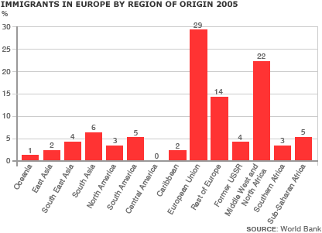

Slide 21
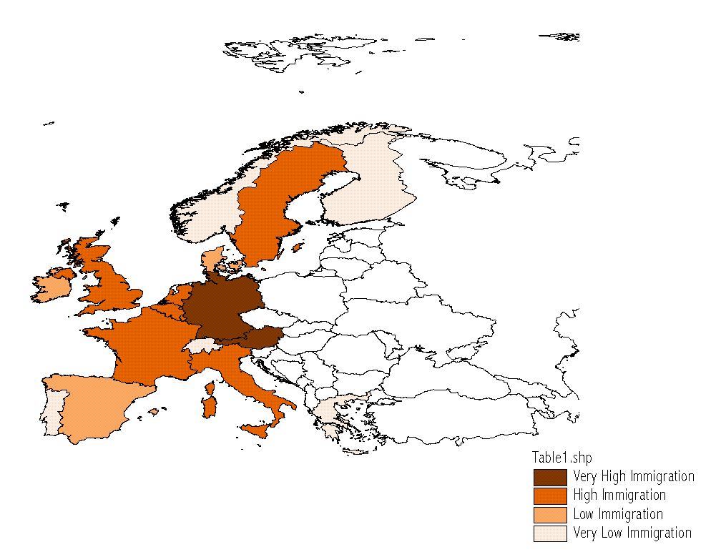
Immigration to Selected Western European Countries from CEEC – Delphi survey, N=15 and 9 – Czech experts, 2003

Slide 22
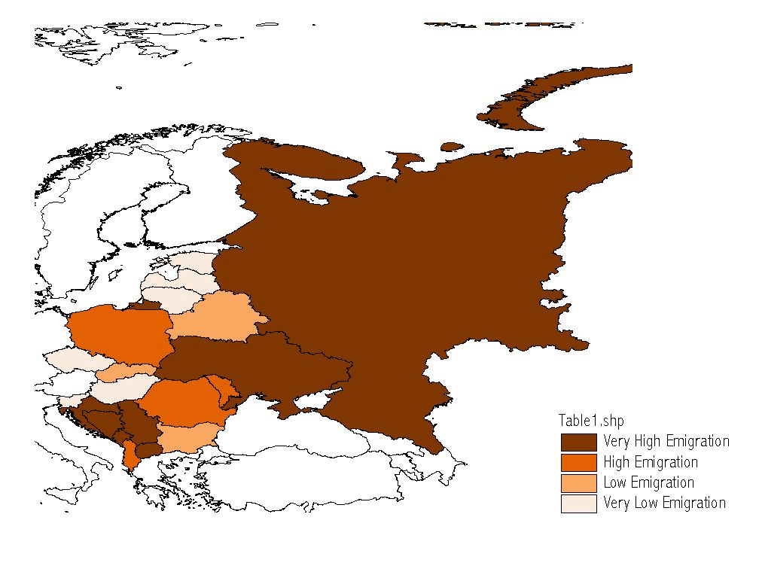
Emigration from Selected CEEC to Western Europe – Delphi survey, N=15 and 9 – Czech experts, 2003

Slide 23
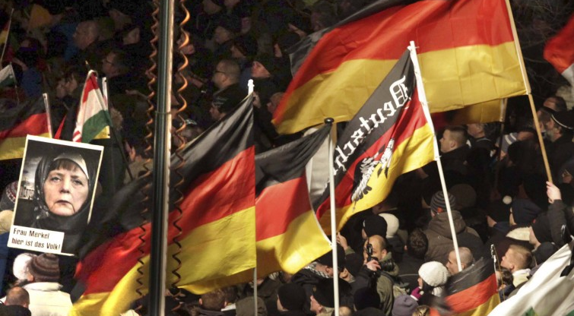

Slide 24
