Slide 1


COMPARATIVE SOCIOLOGY IN CONTEMPORARY SOCIAL KNOWLEDGE:
Basic Trends and Empirical Evidence
International Conference
“COMPARATIVE RESEARCH: CHALLENGES TO SOCIOLOGICAL THEORY AND PRACTICE”
Kyiv , 19-20 May 2016
Dr., Prof. Andrey V. Rezaev
Dr. Natalia D. Tregubova
Dmitrii M. Zhikharevich
St. Petersburg State University,
International Research Laboratory “TANDEM”

Slide 2
An outline
Introduction. Objectives and goals. Sources and materials.
Research problem and theoretical debates
Comparative sociology as an inquiry: empirical evidence
Comparative sociology as a teaching discipline: empirical evidence

Slide 3
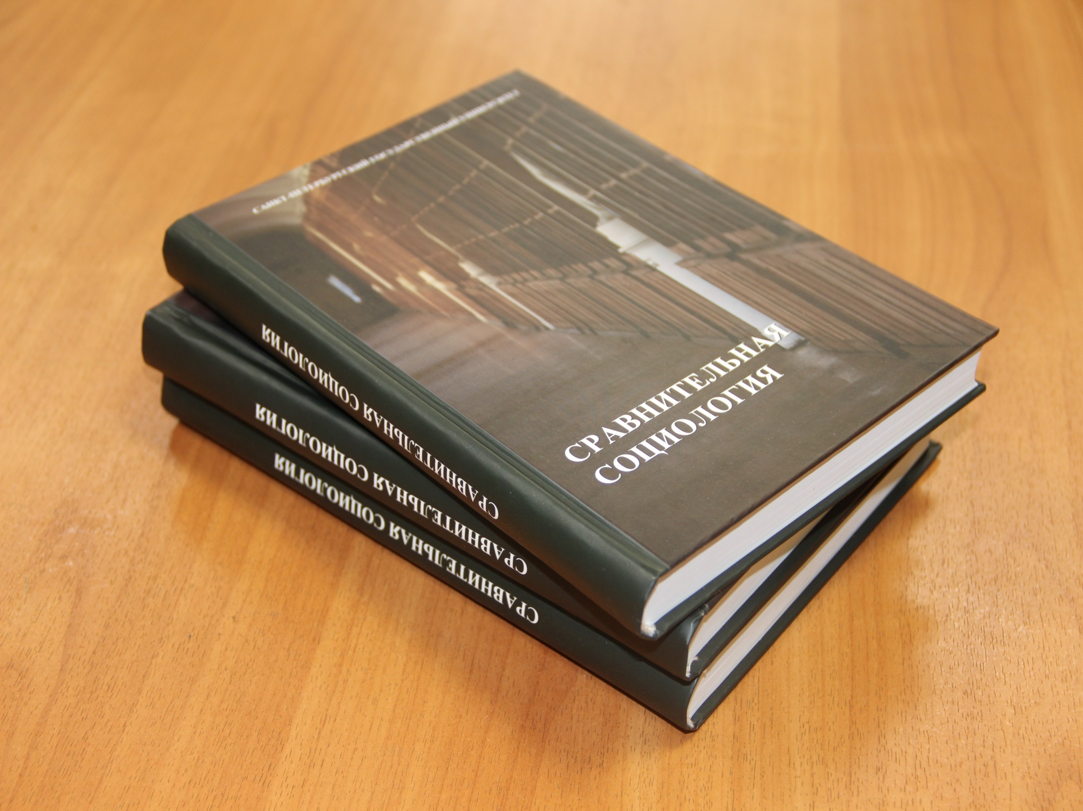

Slide 4


Slide 5


Slide 6
THEORETICAL DEBATES
IN COMPARATIVE SOCIOLOGY :
Basic Trends

Slide 7
What IS “comparative sociology”?
comparative sociology is a sociology itself
comparative sociology as a branch / subfield: comparative (historical) macro-sociology
comparative sociology as a method: a set of sociological methods to establish causal relations

Slide 8
What IS “comparative sociology”?
SPURIOUS DILEMMA – branch vs. method
ACTUAL DILEMMA – “technique-centered” vs. “research–questions–centered” perspective
«компаративистика» vs. ‘comparative sociology’ in the tradition of Russian social sciences and humanities

Slide 9
What IS “comparative sociology”?
A “third way” of understanding comparative sociology – it is neither a method, nor a subfield, but a special organization of research.
This research process is realized through a series of studies that could be descriptive or explanatory, theoretical or empirical, comparative case studies, small-N or large-N comparisons.

Slide 10
What IS “comparative sociology”?
An ideal type of sociology
A research process
A critique
“Comparative sociology is not a field, but a critique of whatever seems narrow and reductionist in sociology. The disappearance of the term will mean either the great success of the great failure of this critique” (Wallerstein 2003: 103)

Slide 11
What IS “comparative sociology”?
Comparative sociology as an inquiry
Comparative sociology as a teaching discipline
Hypothesis: Comparative sociology as an organization of research process is acknowledged and practiced by sociologists and social scientists yet the reality of teaching sociology doesn’t support these practices but rather contradict them.

Slide 12
COMPARATIVE SOCIOLOGY
AS AN INQUIRY :
Empirical Evidence

Slide 13
Content analysis of publications in comparative (historical) sociology
Seven cases: USA, Britain, France, Germany, China, Russia, and inter/transnational level
One / two non-specialized sociological journals for each case, current issues (since 2000)
Articles and reviews on comparative sociology ( “comparative” OR “comparison” in the title or annotation) – 445 items
Articles and reviews on comparative historical sociology ( “comparative” AND “historical” in the title or annotation) – 73 items

Slide 14
Seven cases:
Different levels of institutionalization
Case | Section in (inter)national association
International | Historical and Comparative Sociology working group Comparative Sociology research committee
USA | Section on Comparative and Historical sociology
Britain | Study group on Historical and Comparative sociology
Germany | Section on sociology of development and social anthropology Section on biography research
Russia | Research committee on social transformations and sociology of development Research committee on biography and society
France | Thematic network on life course and social dynamics
China | Social Development and Social Security Committee

Slide 15
Seven cases:
Journals and terms
Case | Journal | Words for search
International | International sociology (IS) | Comparison; comparative; historical
 | Current sociology (CS) | Comparison; comparative; historical
USA | American sociological review (ASR) | Comparison; comparative; historical
 | American journal of sociology (AJS) | Comparison; comparative; historical
UK | British journal of sociology (BJS) | Comparison; comparative; historical
France | Revue française de sociologie (RFS) | Comparaison / comparison; comparatif / comparative; historique / historic / historical
Germany | Zeitschrift fur Soziologie (ZS) | Vergleigh / Komparation / comparison; Vergleichend* / komparativ* / comparative; historisch* / geschichtlich* / historical
China | Shèhuì xué yánjiū (SXY) | Bǐjiào / comparison, comparative; Lìshǐ de / historical
Russia | Sotsiologicheskiye issledovaniya (SI) | Sravneniye / comparison; sravnitel’nyi / komparativny / comparative; istoricheckii / historical

Slide 16
Comparative sociology as an inquiry: Similarity in difference
Comparison is used more as a research design than as a method. Wordings comparison, comparative analysis, comparative study / research point to the way of organizing the research process.
Two general logics of empirical research: comparison determined by “variables” or by “cases”.
Comparison of theories and comparison of methods correspond to a different type of research that is based on development of our cognitive tools.

Slide 17
Comparative and / or historical sociology?

Slide 18
Comparative historical researches / sociologies
Comparative historical research is almost synonymous to “small-N”.
The West vs. the Rest opposition characterizes almost all the cases. The exception is the “American” type that works with time and space localities and is based on the elaborated theoretical framework.
The West vs. the Rest opposition can be interpreted either in terms of modernization theory or through civilizational analysis.

Slide 19
COMPARATIVE SOCIOLOGY
AS A TEACHING DISCIPLINE:
Empirical Evidence

Slide 20
Content analysis of educational materials on comparative (historical) sociology
Seven cases: USA, Britain, France, Germany, China, Russia, and inter/transnational level.
For national cases: departments / faculties of sociology / social sciences in universities that are at the top of the national rankings.
For international case: transnational higher education.
Three kinds of data: courses taught (syllabi); research interests of lecturers/instructors; research centers of sociology / social sciences departments (only for six national cases).

Slide 21
Content analysis of educational materials on comparative (historical) sociology
The search was made:
  for compar* / cross* and their equivalents;
  for courses with historical sociology / historical studies;
  if the title contains general term that presupposes comparative perspective ;
  if the title indicates issues of methodology or methods.
Apparently non-sociological courses (e.g., comparative political science) were removed.

Slide 22
Comparative sociology as a teaching discipline: Research-education gap
  The majority of courses related to comparative sociology is taught in graduate programs.
  The dominant formulations are comparative methods and comparative perspectives. Comparative sociology and comparative methods are mentioned much less often.
  The reality of teaching classes contradicts the instructor’s research interests.

Slide 23
Comparative sociology as a teaching discipline: Research-education gap
  Comparative sociology as an inquiry – our research shows – is not taught as a teaching discipline.
  Thus, hypothesis is confirmed: the necessity of comparative sociology as an inquiry is acknowledged by sociologists and social scientists in general but its characteristics make it difficult to produce in teaching.

Slide 24
Thank you for your attention!
n.tregubova@spbu.ru
tandem.spbu.ru

